Slide 1
ENG-101
English Comprehension
Lessons: 07-10
Virtual University of Pakistan

Slide 2
Word Formation: Suffix Lesson No. 07

Slide 3
Word Formation
When you are reading, you will come across unfamiliar words. It is often possible to guess the meanings of these words if you understand the way words are generally formed in English. Learning the use and meaning of words in English can be made easier, and even enjoyable, if you understand something about the way in which many English words are formed.
An English word can be divided into three parts:
Prefix
Stem
Suffix.

Slide 4
Word Formation
Prefix
Pre-means ‘before’ and therefore, is what comes before the stem.
Example
Consider as an example, the prefix de-(meaning ‘reduce’ or ‘reverse’) in a word like demagnetize (‘to deprive of magnetism’).
Suffix
A suffix is what is attached to the end of the stem.
Example
Consider as an example the suffix -er (meaning (‘someone who’) in programmer (‘the person who programs’).
Both prefixes and suffixes are referred to as affixes.

Slide 5
Stem
The stem of a word is its basic form, the fundamental element which is common to all the other forms of the word. A prefix is a form which is fixed to the beginning of a stem; a suffix is a form which is fixed to the end of a stem.
Example
Stem = measure
Suffix= measurable
Prefix =immeasurable

Slide 6
Difference between Prefix and Suffix
Prefix: it changes the meaning of the word
Example: Pleasant/un-pleasant
Suffix: it changes the form of the word.
Example: Follow/follow-ed

Slide 7
Examples of some Suffixes
Nouns Verbs Adjectives Adverb
-ance -ize -able -ly
-ence -ate -ible
-or -fy -less
-er -en -ic
-ist -ify -ical
-ness -d -ish
-ment

Slide 8
P R A C T I C E
Nation
Nation (Noun)
Nation-al (Adjective)
Nation-al-ity (Noun)
Nation-al-ize (Verb)
Nation-al-iz-ation (Noun)
Nation-al-ism (Noun)
Inter-nation-al-ly (Adverb)

Slide 9
Locating Base Words
It is sometimes difficult to locate base word, because their spellings frequently change when suffixes are added to them.
If a base word ends in e, the e may be dropped when a suffix is added to it.
Mature +it y=maturity
If a base word ends in y, the y may be changed to i ,when a suffix is added to it:
harmony +ous=harmonious
Base words may undergo other spelling changes when suffixes are added to them:
reclaim+ation=reclamation (the I in reclaim is dropped)

Slide 10
Recap
An English word can be divided into three parts: a prefix, a stem and a suffix. Prefix is what comes before the stem. A suffix is what is attached to the end of the stem. A stem is the root of the word. Both prefixes and suffixes are referred to as Affixes.

Slide 11
Word Formation- Prefixes
Lesson -08

Slide 12
Prefix
A prefix is a letter or group of letters that is added to the beginning of a stem/ base word e.g. in untrue the prefix is un- and the stem/base word is true.
They change the meaning of the base word. Un + happy = unhappy Re + do = redo Prefixes

Slide 13
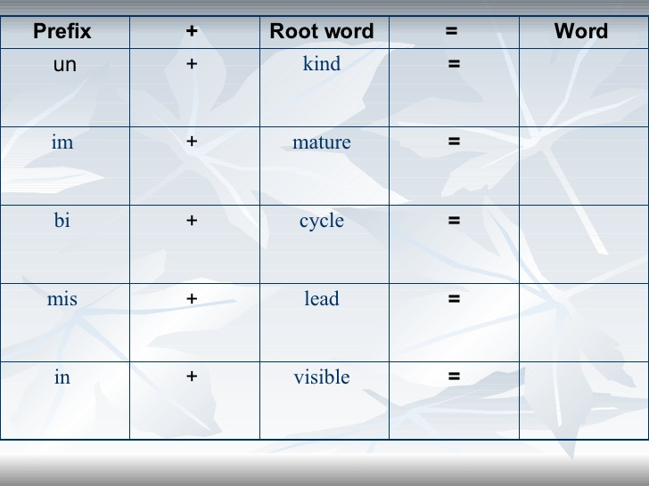

Slide 14
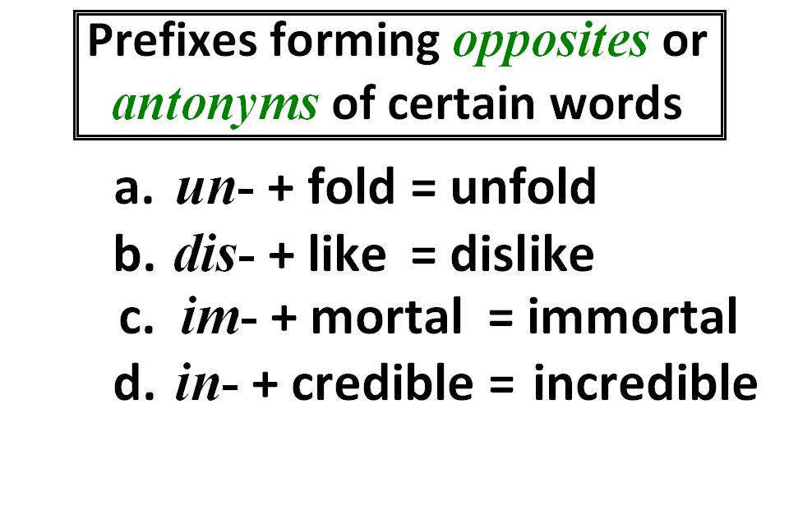

Slide 15
Synonyms
Synonyms are words that have the same or nearly the same meaning. For example, big large, huge, enormous monumental, gigantic, immense, and colossal are synonyms.
Synonyms have two characteristics
1.Most synonyms have similar meanings in only one of their senses e.g., appropriate and apt are synonyms when they are used to indicate that something is ‘fit’ for a specific purpose.
He made an appropriate remark
He made an apt remark

Slide 16
Synonyms
2.Synonyms often have shades of meaning in addition to the meaning they share.
For instance blame and denounce are synonyms that refer to the act of making an unfavourable judgement. However, to blame is to fix the responsibility for an error whereas to denounce is to state intense disapproval in public.

Slide 17
Recap
We have dealt with “Vocabulary Building” in this lesson by focussing on Affixes-Prefixes.

Slide 18
Reading: Description, Locating Information, Organizing Information
Lesson No.09

Slide 19
Characteristics
When you read a text about some topic like an article, you need to do the following things to locate some information.
remember to try and understand the meaning of new words and expressions from the context.
Don’t check new words in the dictionary until you have read the whole text.

Slide 20
Context clues used to find word meaning:
the surrounding text
examples of the new word
synonyms: a word that means the same as another word
antonyms: a word opposite in meaning to another word

Slide 21
Locating Information Exercise-1
Using the surrounding text, choose the meaning of the bold-faced word.
On an impulse, Carla bought a lot of merchandise at the store’s “going out of business” sale. She later regretted that she hadn’t planned her purchases more carefully.
1. dare
2. review
3. sudden wish or urge

Slide 22
Exercise-2
Using the surrounding text, choose the meaning of the bold-faced word.
“Mr. Allen,” said the instructor, “please cease cracking your gum in class.”
1. enjoy
2. begin
3. stop

Slide 23
Organizing Information
A paragraph is a group of related sentences that develop an idea. In nearly every paragraph, there is one idea that is more important than others. This idea is called the main idea of the paragraph and is usually found at the beginning of the paragraph.

Slide 24
Sample Paragraph
It is the incredible speed of computers along with their memory capacity that make them so useful and valuable. Computers can solve problems in a fraction of time. For this reason, they are used in business to keep the record of accounts and airlines, train lines and bus lines use them to keep track of ticket sales. As for memory, modern computers can store information with high accuracy and reliability. A computer can put data into its ‘memory’ and retrieve it in a few millionths of a second. It also has a storage capacity for as many as a million items.

Slide 25
If you were to organize this paragraph into its three components, it would look like this:
Main idea: It is the incredible speed of computers along with their memory capacity that make them so useful and valuable
Major details: a. Computers can solve problems in a fraction of time
b. As for memory, modern computers can store information with high accuracy and reliability
Minor Details: a. Computers are used in business to keep their accounts.
b. Airlines train lines bus lines use them to keep track of ticket sales

Slide 26
Reading: Word Forms, Contextual References
Lesson No.10

Slide 27
Words Forms
First choose the appropriate form of the words to complete the sentences. Then check the differences of meaning in your dictionary.
measurement, measure, measured, measurable
a. The analog computer is essentially used for problems is involving ……………
b. Because computer equipment is often bulky, the area used for a computer installation must be………… out carefully.
c. The number of employees a computer company has can be seen as a…….. of its success in the business world.

Slide 28
Answers:
The analog computer is essentially used for problems is involving measurement.
b. Because computer equipment is often bulky, the area used for a computer installation must be measured out carefully.
The number of employees a computer company has can be seen as a measure of its success in the business world.

Slide 29
Contextual Reference
The students have spent many hours studying for their examinations. The antecedent of ‘their’ is ‘students’.
Each of the wild horses raced for its freedom.
Neither of my sons ever feels like cleaning his room.
The worst thing about my note writing letters is that you never get any back.
The writer begins with the first person pronoun my, but then shifts to the second person pronoun you).

Slide 30


